Slide 1










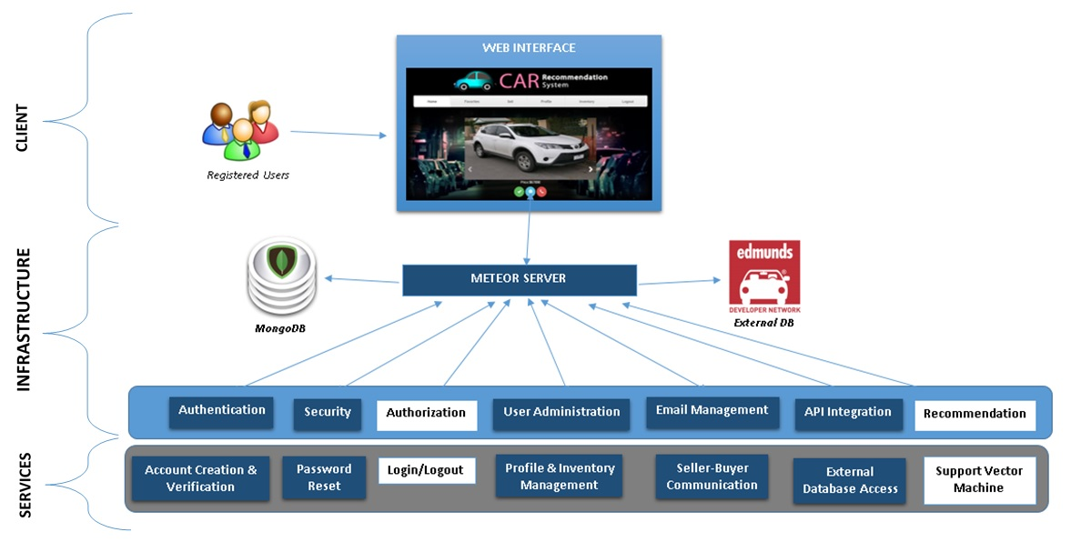
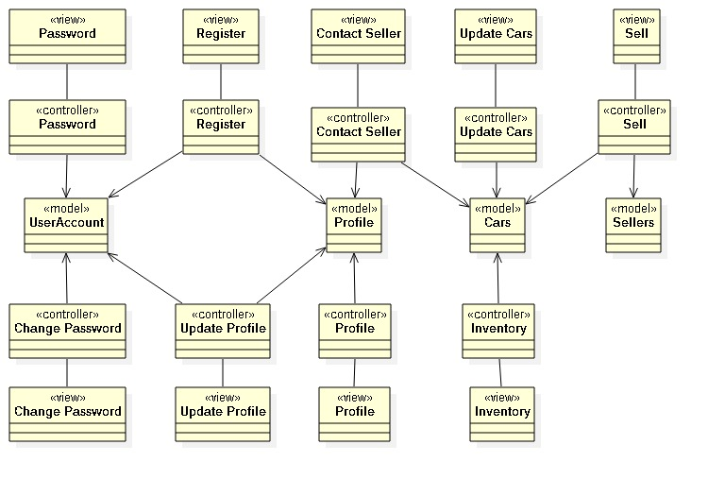
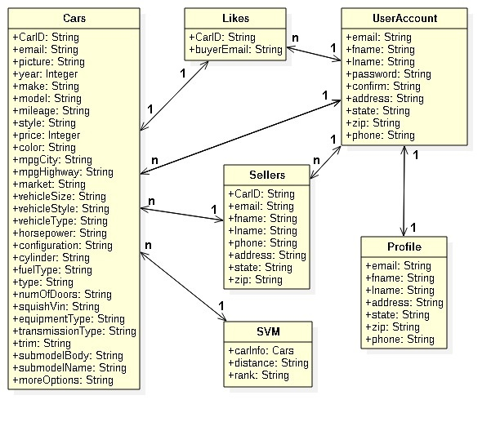
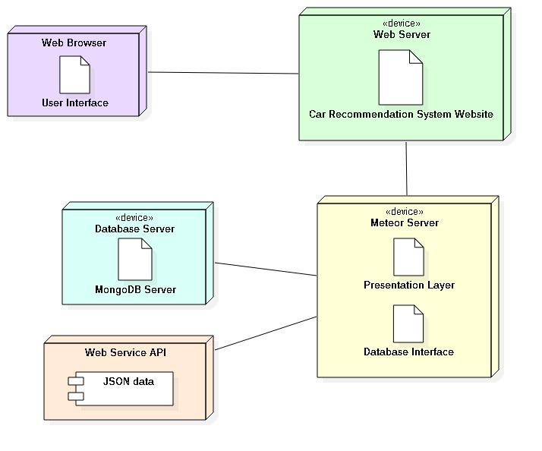
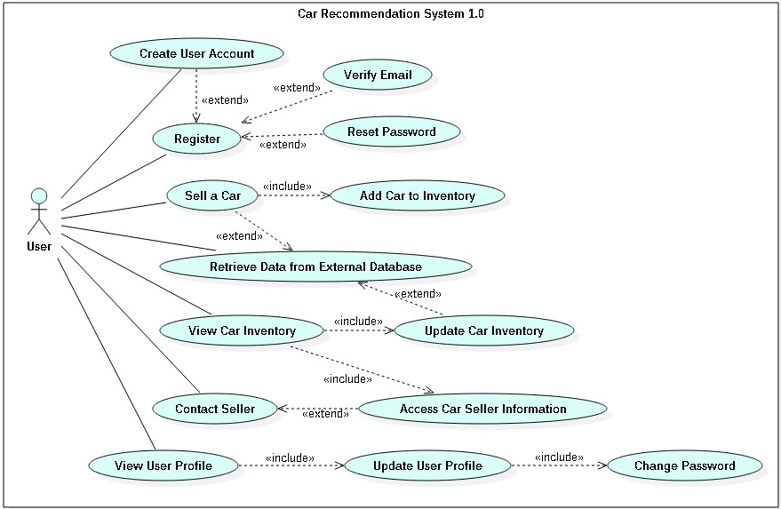
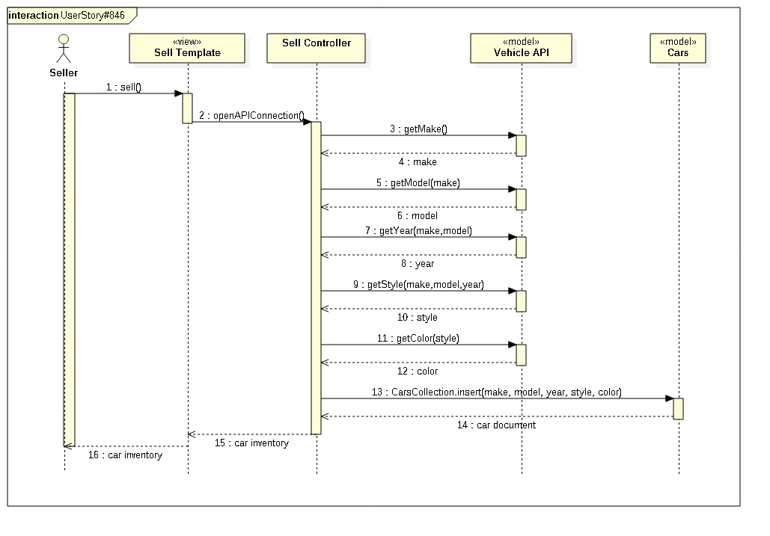
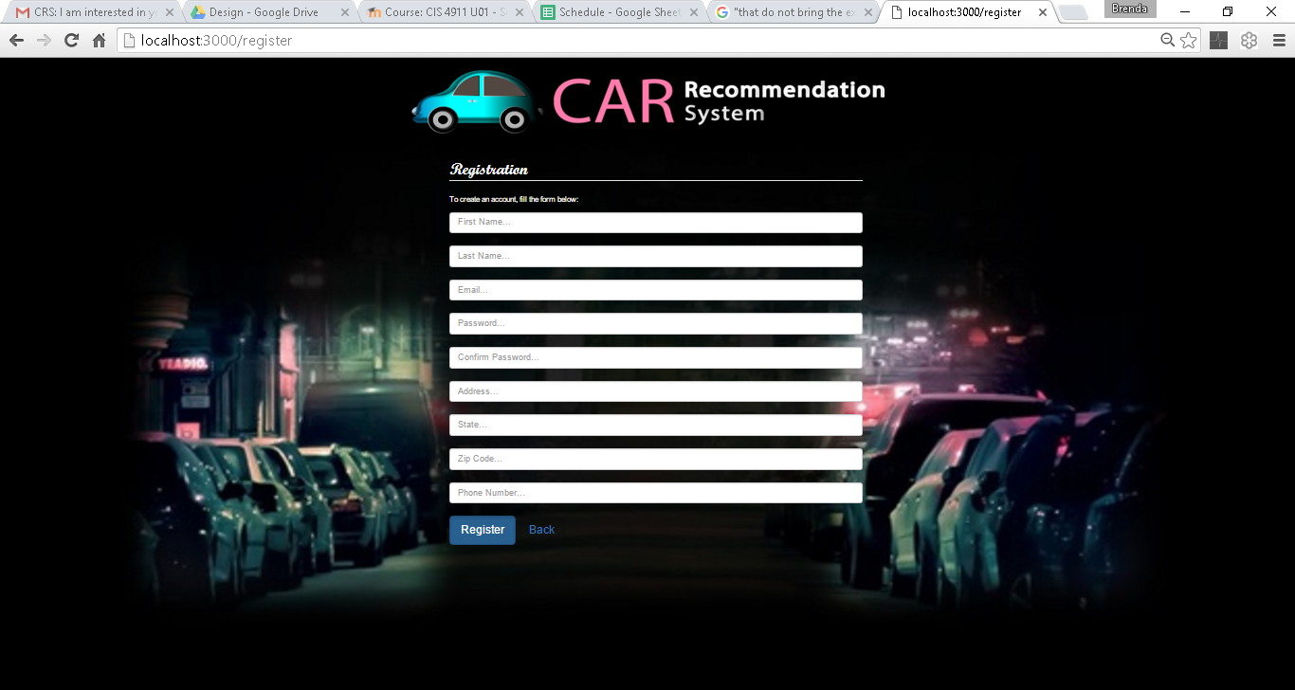
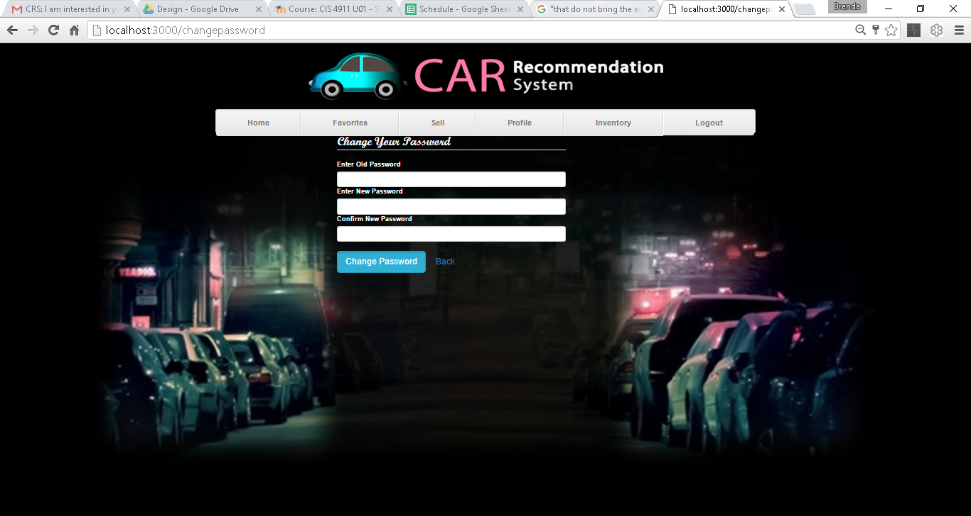
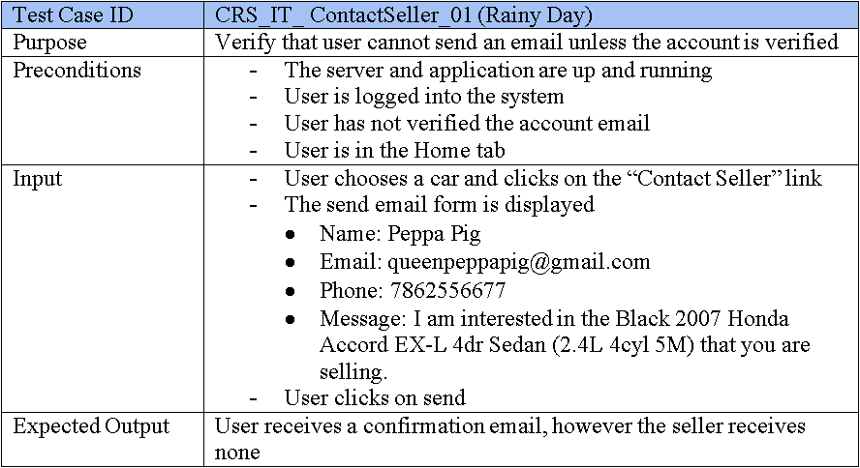
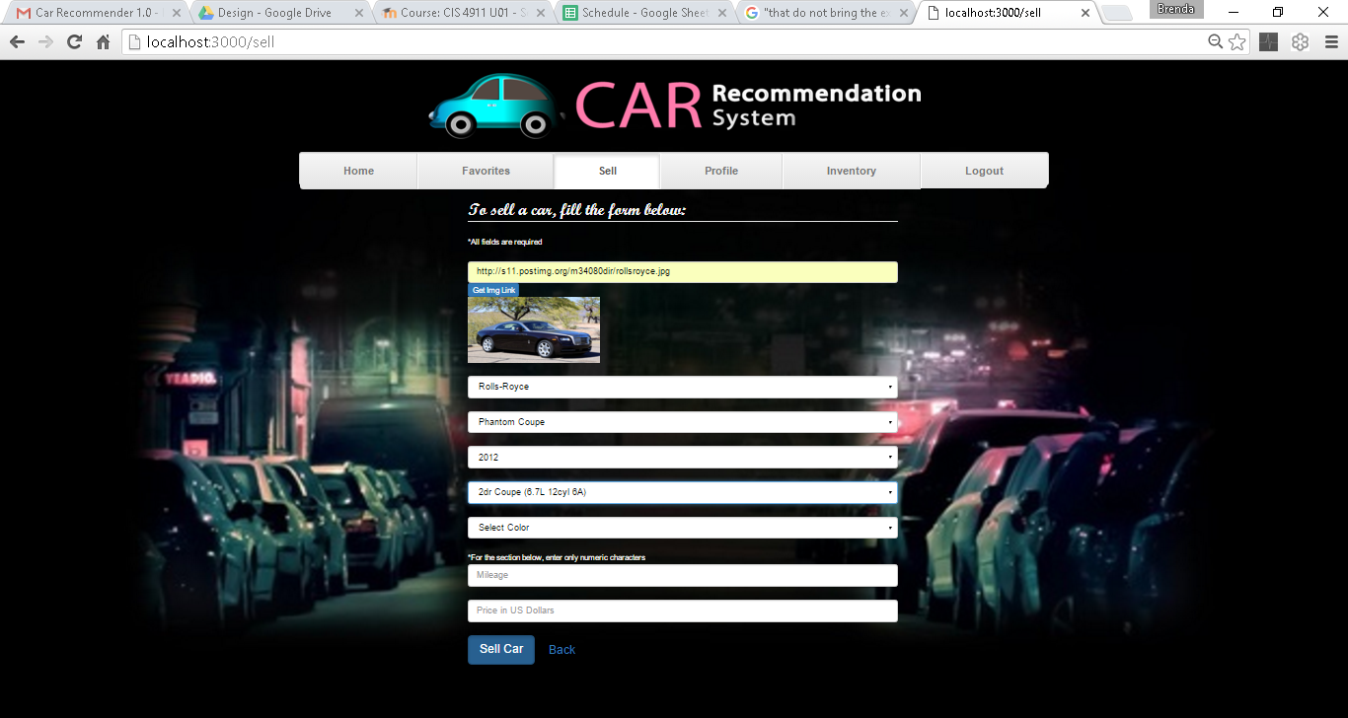
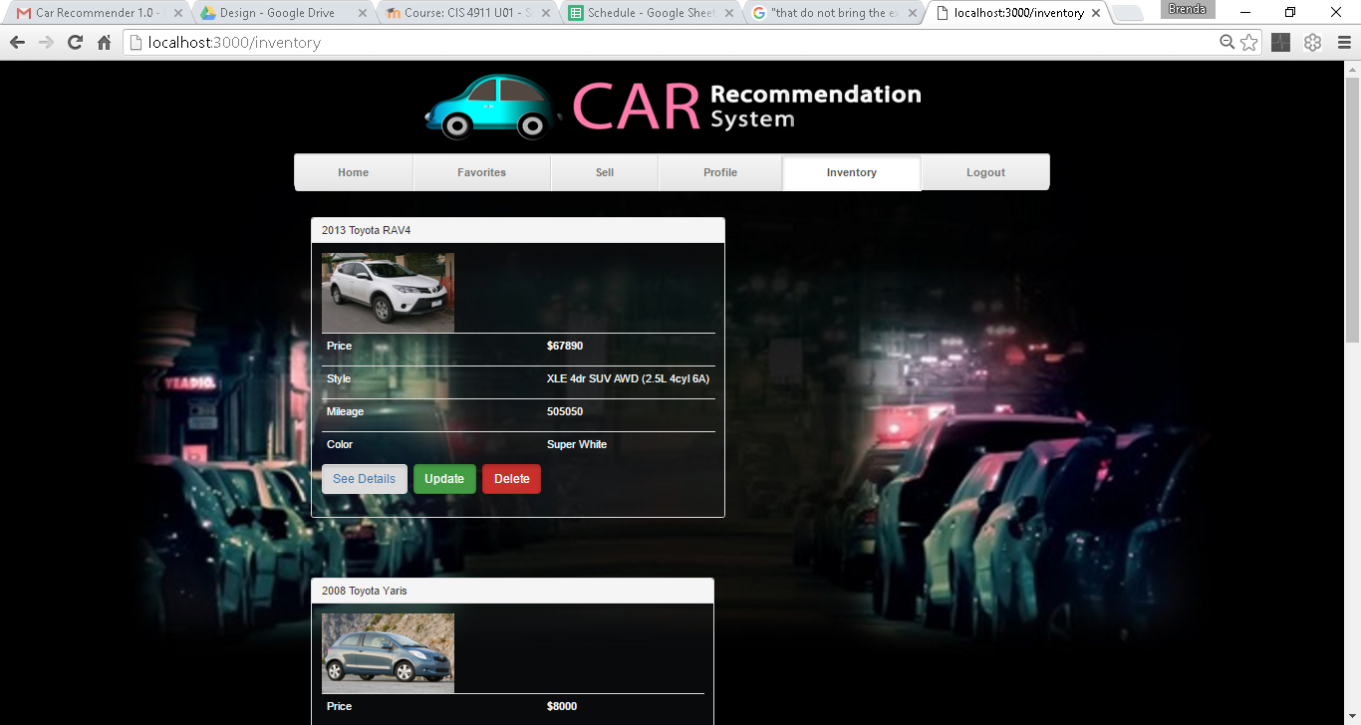
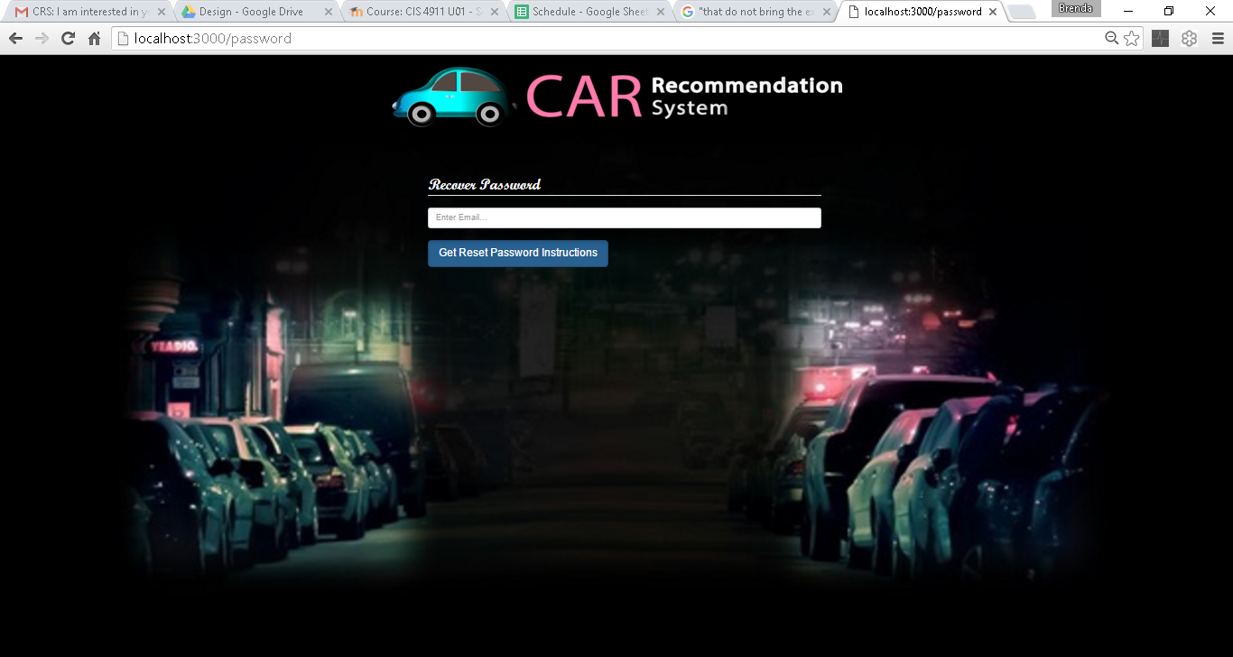
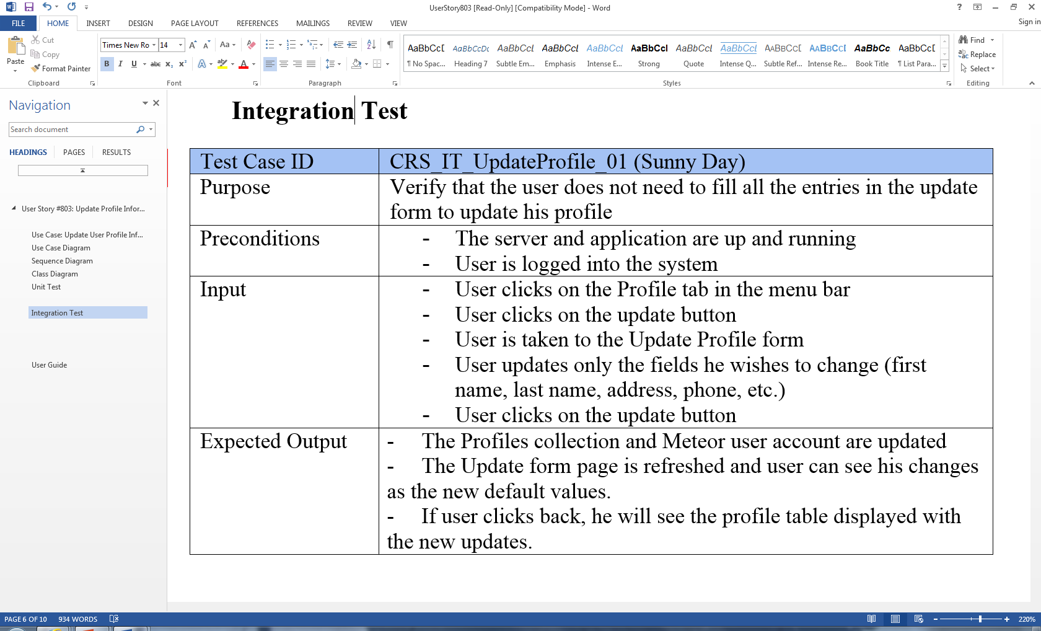
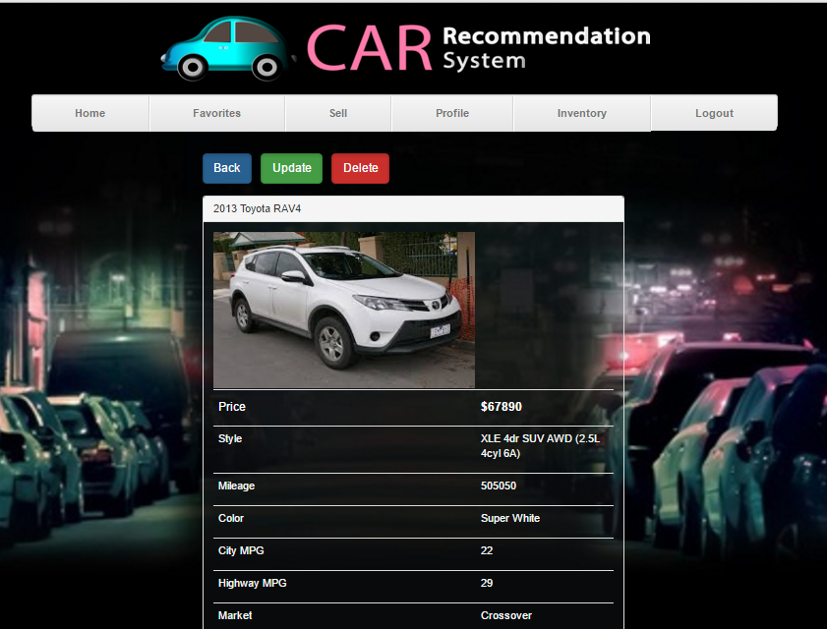
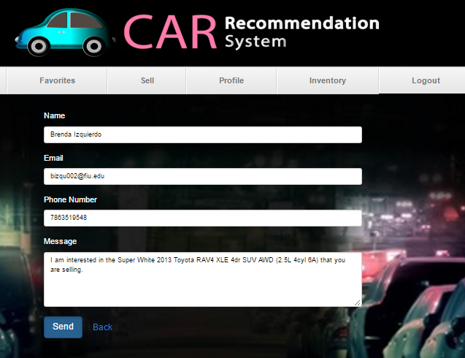
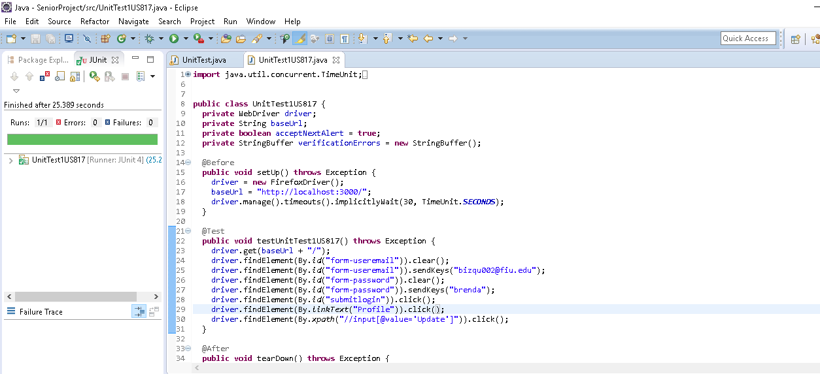
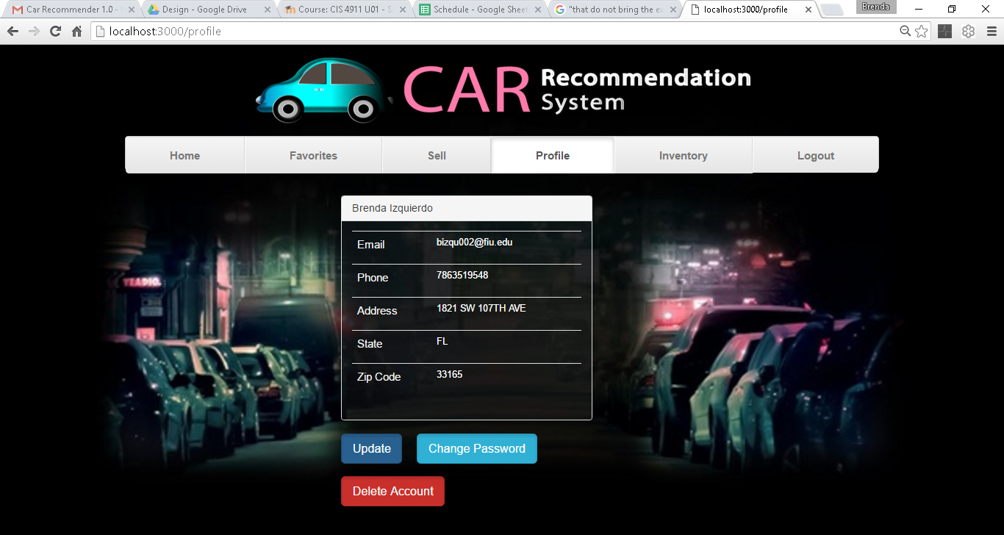
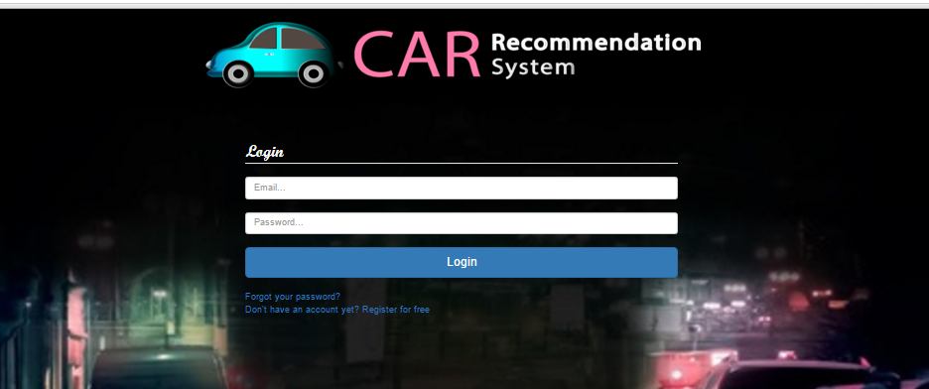
School of Computing & Information Sciences
Senior Project, 2016, Spring
Car Recommendation System
Student: Brenda Izquierdo, Florida International University
Mentor: Dr. David Villegas, RE Console
Instructor: Dr. Masoud Sadjadi, Florida International University
Problem
Current System
Requirements
In the current car market, where there are thousands of cars with different features and styles, it takes an inordinate amount of time and effort for prospective buyers to find the type of car they want. Whole days can be spent visiting dealerships, with the buyer being at the mercy of devious car dealers. On the other hand, although shopping online is quick, efficient, and stress-free, users are compelled to constantly set and reset filters to search for the car they want based on the make, model, type, price, mileage, color, engine, etc. The Internet has also made selling cars easier than ever, however it is still difficult to reach prospective buyers, worse yet, fees are frequently charged for online marketing services that do not bring the expected results.
Recommendation systems are taking more importance in online businesses, where the ability to propose a new item or product that a user will like can increase sales substantially. In this project, we implemented a web page where users can view cars and give feedback through likes and ratings. Then the system will run algorithms to come up with similar cars to show the user. These algorithms can range from simple similarity measures to more complex machine learning models such as the Support Vector Machine, implemented for the main recommendation process. Clients can also use this web page to sell cars and manage their own inventory.
Users will be able to create an account, verify that account, login, logout, sell a car, view a car’s information, keep a favorite list, update profile, update inventory, change password, recover password, see recommended cars, view a map with the location of any car, contact seller from the application, and search for cars. My work involved:
UX/UI: Logo, background, web content design. Front-End/Back-End: REST API calls, JSON parsing, system logic, seller-buyer email communication, user data and inventory display. Authentication: Account creation and verification, password reset.
Database Administration: Create and manage collections. Insert, query and modify documents, and work with external databases.
System Design
Object Design
Implementation
Verification
Screenshots
Summary
The Car Recommendation System (CRS) is a website that helps users find the perfect car by constantly recommending a best match based on their preference. Furthermore, it allows clients to put their cars for sale as well. My work in the project involves the registration, car sale, seller-buyer communication, verification and security, and profile and inventory management features. Ultimately, this system provides all the functionalities and requirements described above in the most efficient and effective way possible.
Acknowledgements
I am very thankful for the priceless advice, guidance, and feedback I received from Dr. David Villegas.
I would like to also thank my teammate Zeev Feldbeine for always doing his part of the work in time and with quality.

